Slide 1

How Best Buy and P.C. Richard make money, and where Company X wins
INDEPENDENT CASE STUDY · COMPANY NAME WITHHELD
How should a small online marketplace enter consumer electronics?
Prathamesh Adarkar · Independent case study · 2026

Slide 2
The brief had three parts. Here is how this deck answers them
THE BRIEF
01
02
03
04
Understand the consumer electronics business
Study Best Buy’s model
Study P.C. Richard’s model and visit both stores
What it means for Company X
Market size, growth, and where the profit actually sits
FY26 annual report, Aug 2026 earnings call, policies
Company history, policies, online sales, store walk
The shop, the numbers, the role and the first 90 days
Slides 4 - 5
Slides 6 - 8
Slides 9 - 11
Slides 12 - 20
Independent case study: public filings, published policies, three store visits and a planning model

Slide 3
Electronics is a thin-margin business. Company X wins by curating, not out-sizing
THE SHORT ANSWER
1
Best Buy keeps about 4 cents of every dollar
MY RECOMMENDATION
After product cost and running costs, adjusted operating profit is 4.3% of sales. The profit comes from what surrounds the box: services, membership, ads, credit card and brand funding.
Launch a Company X Electronics Shop as a 90-day pilot
2
The two leaders win in different ways
Samsung products bought and sold by Company X
Accessories dropshipped from distributors
Capped first buy and loss limit
Weekly scorecard; expand only what earns money
Best Buy: National scale, computing-led, paid membership and a new curated marketplace.
P.C. Richard: 4 states, appliance and TV delivery, own service centers, free loyalty club.
3
It cannot out-scale them. It can out-curate them
A focused Samsung shop with clear terms, sold by Company X, plus dropshipped accessories that grow the catalog without inventory.
Sources: Best Buy FY26 results (8-K, Mar 3 2026); Best Buy Q2 FY27 results (Aug 27 2026); P.C. Richard company history page.

Slide 4
A huge market growing slowly. Growth now comes from price and mix, not more units
1 · THE CONSUMER ELECTRONICS BUSINESS
$371B
US consumer tech hardware retail revenue, 2026 forecast (CTA). +3.4% vs 2025
~1%
Circana’s August 2026 revenue growth forecast for 2026; below 1% a year in 2027–28
~3%
Average price increase in 2026 (Circana); memory costs are pushing prices up
Circana: notebook PCs are the single largest growth contributor in 2026, about +$1.7B.
Sources: CTA US Consumer Technology Forecast, Jan 2026; Circana forecasts, Jan 6 and Aug 6 2026; Best Buy Q2 FY27 results, Aug 27 2026.
Notes:
Sources:
- CTA forecast: https://www.cta.tech/media/esvft1oq/preview_cta-us-consumer-technology-one-year-industry-forecast-2021-2026-january-2026-1-compressed.pdf
- Circana Aug 2026: https://www.globenewswire.com/news-release/2026/08/06/3340134/0/en/rising-prices-and-americans-focus-on-value-keeps-consumer-technology-revenue-growth-on-a-moderate-track-through-2028-reports-circana.html
- Best Buy Q2 FY27: https://s204.q4cdn.com/864376893/files/doc_earnings/2027/q2/earnings-result/Best-Buy-Reports-Fiscal-Second-Quarter-2027-Results.pdf

Slide 5
Electronics retail keeps about 4 cents of every dollar. The rest of the profit is around the box
1 · THE CONSUMER ELECTRONICS BUSINESS
Brand funding
Vendors reimburse markdowns and sales incentives
Services
$2.47B US services revenue in FY26; 9% of US revenue in Q2 FY27
$77.50 product cost
$18.20 running costs
$4.30 profit
Paid membership
Just over 8M paid members in Feb 2026, aiming for 9M by year-end
FY26: revenue $41.7B, gross margin 22.5%,
adjusted operating margin 4.3%, net earnings $1.07B.
Advertising
Best Buy Ads: $900M collected last year, targeting +10%
The box brings the customer in. The margin is in everything sold around it.
Credit card
~25% of US revenue on Best Buy cards; profit share ≈ 1.2% of US revenue
Sources: Best Buy FY26 results (8-K, Mar 3 2026) and FY26 10-K; Best Buy Q2 FY27 earnings call, Aug 27 2026.

Slide 6
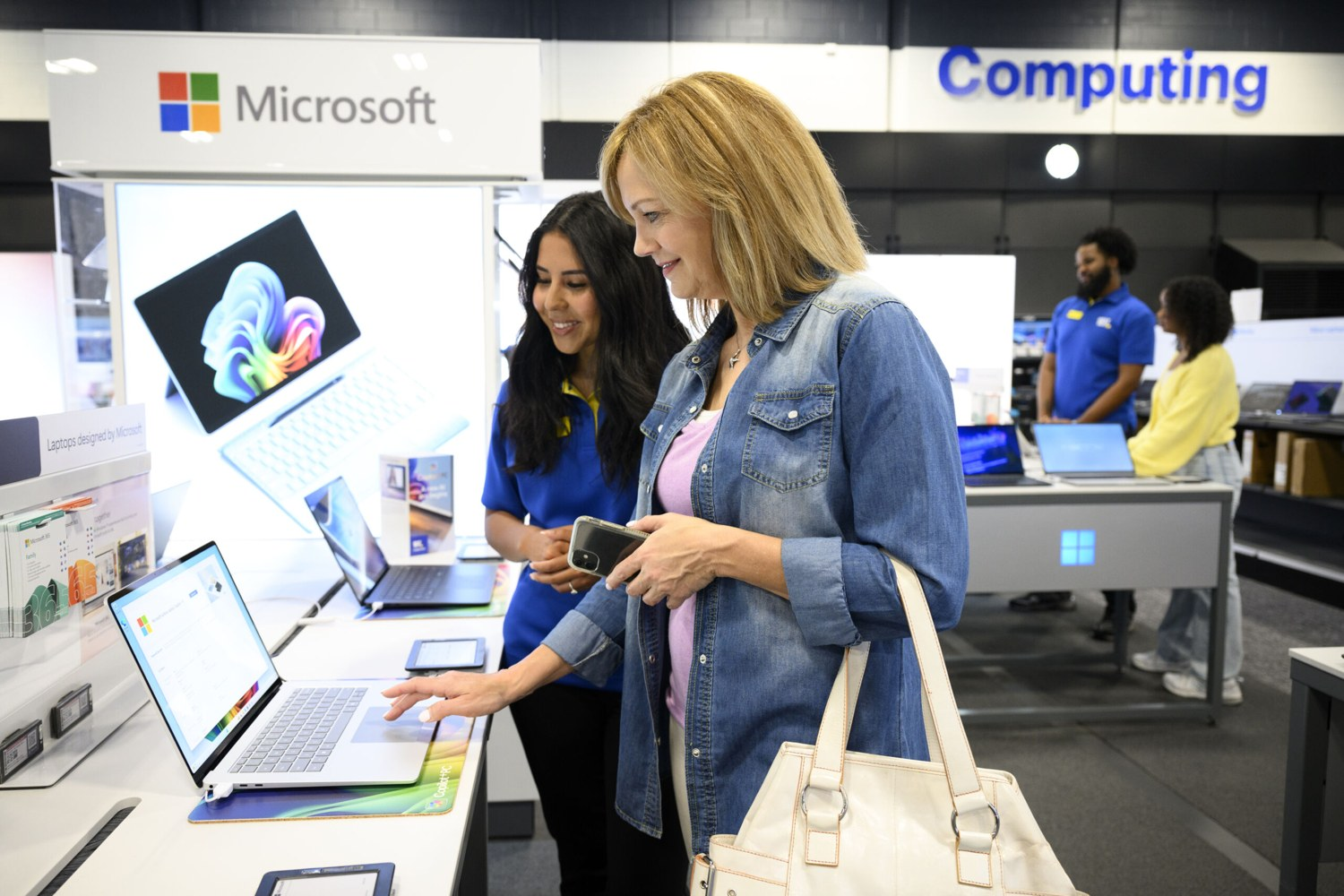
Best Buy: national scale, led by computers and phones
2 · BEST BUY
$41.7B
886
FY26 revenue; FY27 guidance raised to $42.3 to 42.8B
Best Buy stores in the US (926 US locations in total)
34.4%
46%
of US revenue online in FY26 ($13.2B)
of US revenue from computing and mobile phones (Q2 FY27)
22.6%
~82,000
US gross margin in FY26; 24.0% in Q2 FY27
employees in the US and Canada
Momentum: comparable sales increase 4.1% in Q2 FY27, led by computing and phones (6.8%)
Sources: Best Buy FY26 10-K and 8-K; Q2 FY27 results (13 weeks ended Aug 1 2026). Photo: Best Buy corporate press kit.

Slide 7
Best Buy runs six profit engines. Company X can use three of them now
2 · BEST BUY
NOW
NOW
NOW
Product sales
Marketplace
Price discipline
Buy from brands, resell with a thin margin
Curated third-party sellers since Aug 2025
Price match on identical new items
Company X: Samsung sold by Company X (1P)
Company X: Company X already runs one
Company X: Check rival prices before every buy
LATER
LATER
NOT YET
Advertising
Membership
Services
Brands pay for placement: Best Buy Ads
Plus $29.99 / Total $199.99 a year
Geek Squad repair, setup, protection
Company X: Sponsored listings once traffic exists
Company X: Start with a free email club
Company X: Needs staff and partners we don’t have
Sources: Best Buy 10-K FY26; Q2 FY27 call; bestbuy.com price-match and membership pages, checked Oct 16 2026.

Slide 8
Best Buy is now building what Company X already has: a curated marketplace
2 · BEST BUY
$300M
Best Buy marketplace sales (GMV) in Q2 FY27
$1.3B
Marketplace GMV Best Buy expects for FY27
Relaunched Aug 2025, curated: sellers apply and are vetted
Adding international sellers this quarter
Marketplace and Ads lifted Best Buy’s gross margin
At an assumed 6%, Company X’s fee would be the lowest. The limit is not what sellers pay; it is how many shoppers we bring.
Sources: Best Buy Q2 FY27 call (Aug 27 2026); published seller fee schedules for Amazon, Walmart, Newegg and eBay (checked Oct 15 2026).

Slide 9
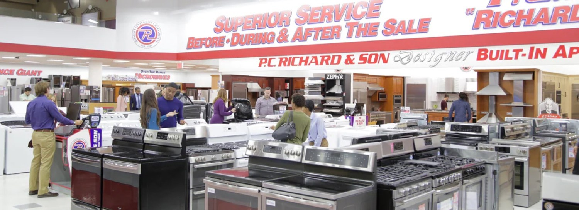
P.C. Richard: regional, family-run, and built on service
3 · P.C. RICHARD & SON
65
Showrooms in NY, NJ, CT and PA (4 in Manhattan)
3 + 2
Distribution centers + service centers
Free
Generations+ club: member prices, free same-day delivery on select items, up to $150 yearly gift
1909
1920s
Today
Hardware store in Bensonhurst, Brooklyn
Becomes an appliance retailer
4th generation; CEO Gregg Richard
30 days
low-price guarantee on identical in-stock items
Motto: “We Service What We Sell.” Service department since 1935.
$221M
pcrichard.com online sales in 2025, up 25 - 30% (estimate)
Sources: pcrichard.com history, memberships and price-guarantee pages (checked Oct 16–17 2026); ECDB pcrichard.com estimate; Wikipedia. Photo: P.C. Richard history page.

Slide 10
Two models, two lessons for Company X
3 · BEST BUY VS P.C. RICHARD
 | Best Buy | P.C. Richard & Son
Reach | National: 886 stores, plus bestbuy.com | 4 States: about 65 showrooms
Leads with | Computers and phones (46% of US sales) | Appliances and TVs, delivered and installed
Membership | Paid: Plus $29.99, Total $199.99 a year | Free: Generations+
Service | Geek Squad, protection plans | Own service centers; repairs what it sells
Price promise | Matches identical new in-stock items | 30-day low price guarantee
Returns | 15 days on most items; 60 for members | 30 days, factory-sealed
Online sales | $13.2B (34.4% of US sales) | About $221M (Estimate)
Lesson for Company X | Make the offer easy to compare | Make 1 person accountable
Sources: company filings and published policies, checked Oct 16 2026. P.C. Richard online figure is an ECDB estimate; returns have product exclusions.

Slide 11
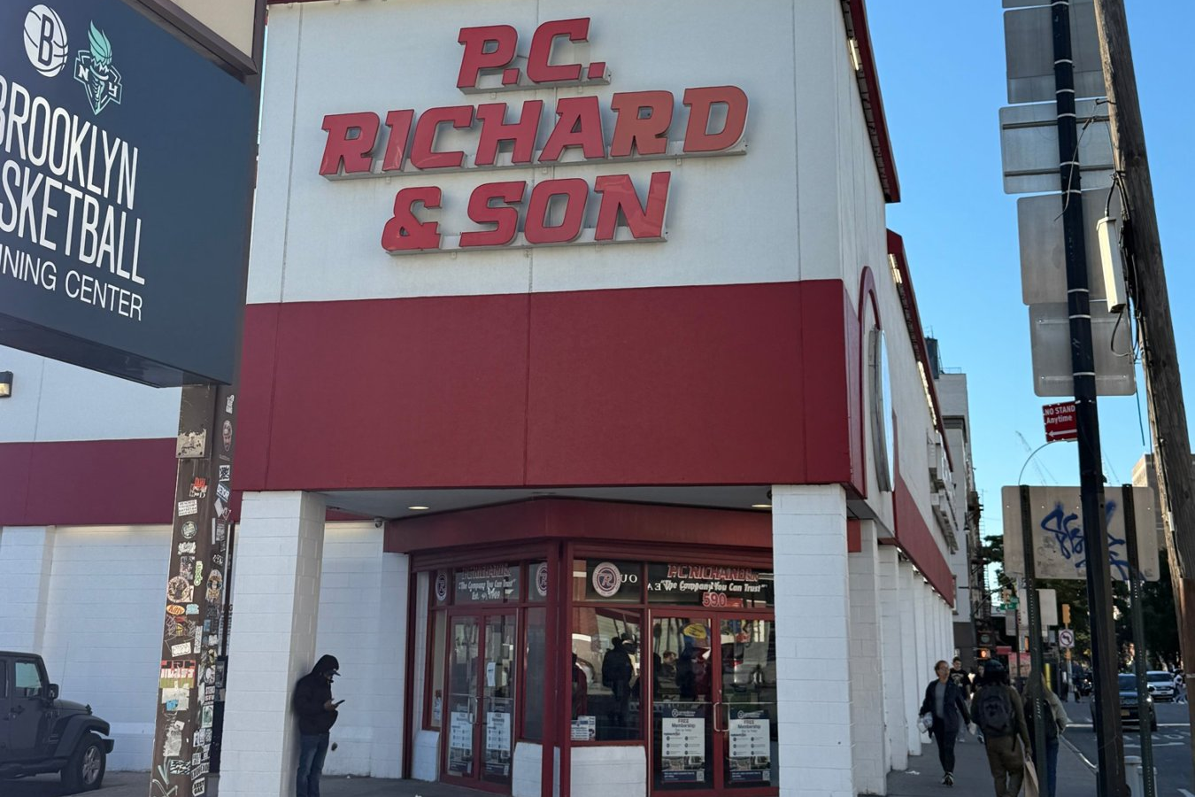
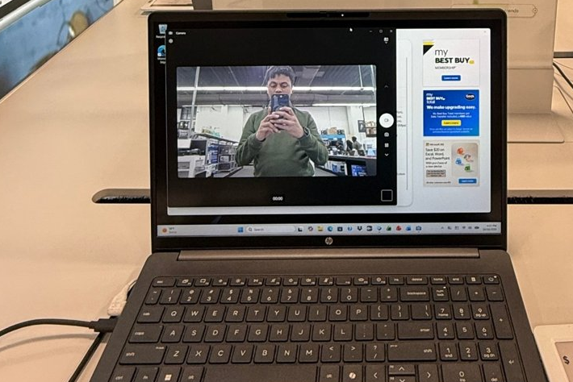
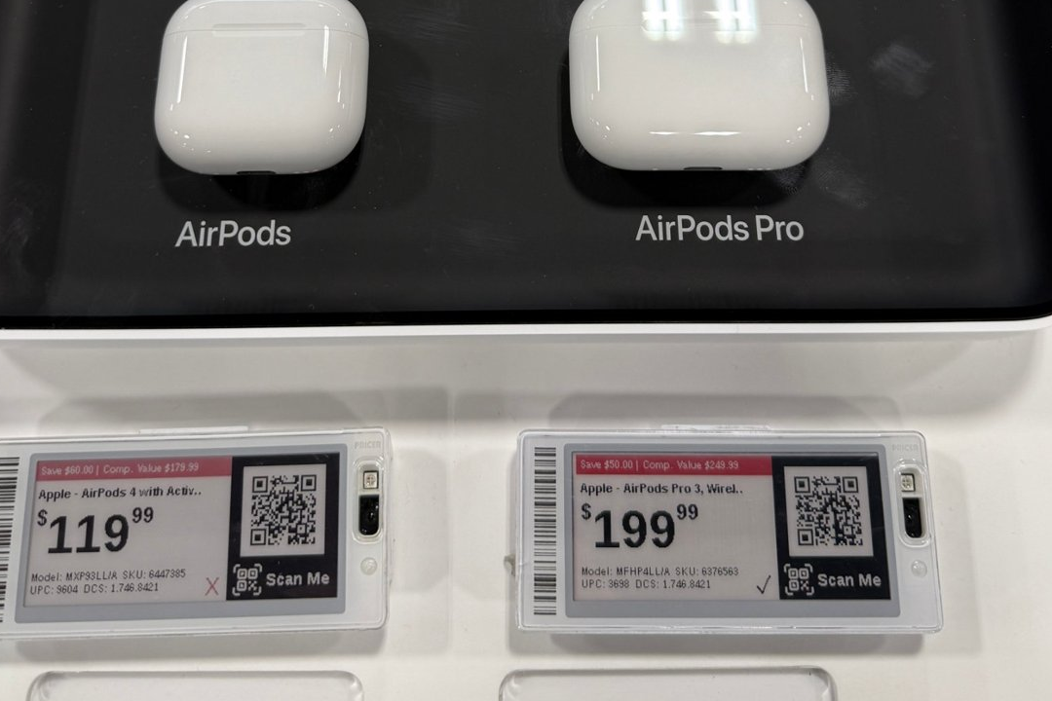
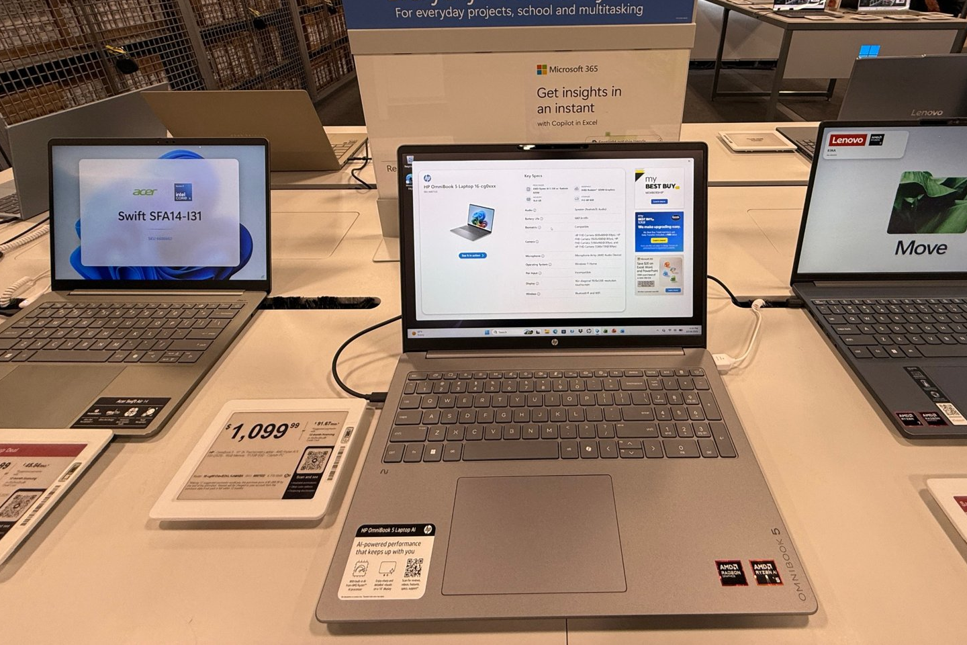
I visited three stores on Sunday, October 18
3 · STORE VISITS
STORES VISITED
P.C. Richard 86th St, Bay Ridge
P.C. Richard 590 Atlantic Ave
Best Buy 625 Atlantic Ave (Atlantic Terminal)
I saw
So Company X should
Big markdowns already
AirPods $50–60 below list; a laptop $150 off
Sell bundles, not cheaper devices
P.C. Richard, 590 Atlantic Ave
Best Buy: me, in the demo laptop’s camera
Monthly payments on every tag
$879.99 laptop = $73.34/mo on the Best Buy card
Offer pay-over-time if checkout allows
Membership on every demo screen
“My Best Buy Total” and Microsoft 365 offers
Show bundles and add-ons on each page
Busy stores, little help
I mostly browsed without anyone stepping in
Fast human answers online: our edge
AirPods, both marked down $50–60
A monthly price on every laptop tag
Photos taken by me on Oct 18 2026. Prices are Best Buy shelf tags that day, before tax.

Slide 12
Where Company X can win: curated, clear and accountable
4 · THE PLAN
Don’t compete on
Compete on
WHAT THE COMPANY ALREADY HAS
A live online marketplace with category shops
A low flat seller fee (6% assumed)
An electronics section with a few laptop listings
A very large catalog goal
A brand supply agreement under discussion (unverified)
Next-day delivery everywhere
Store pickup and installation
The biggest catalog of devices
The lowest price on every model
A focused Samsung selection
Seller, warranty, delivery and returns shown on every page
Useful bundles (earbuds + charger + case)
One named owner for every order
Buying decided by weekly data
A note on blanket discounts: with retail margins near 22% and profit near 4%, a blanket discount on devices would erase the profit. Use price on bundles and accessories, not flagship devices.
Sources: the company’s public pages, reviewed Oct 2026; author’s analysis. Company details generalized.

Slide 13
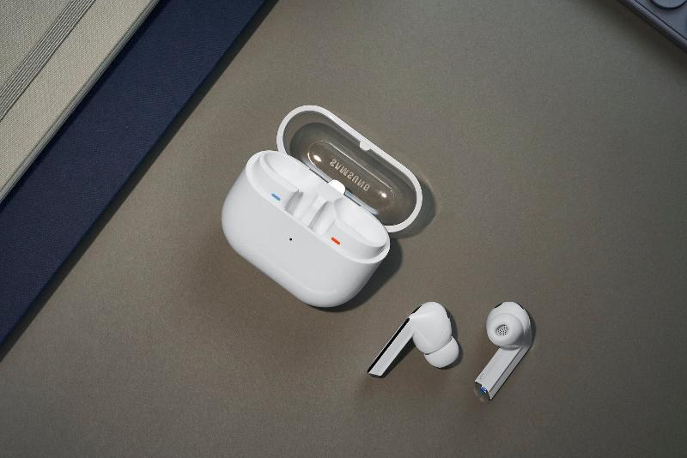
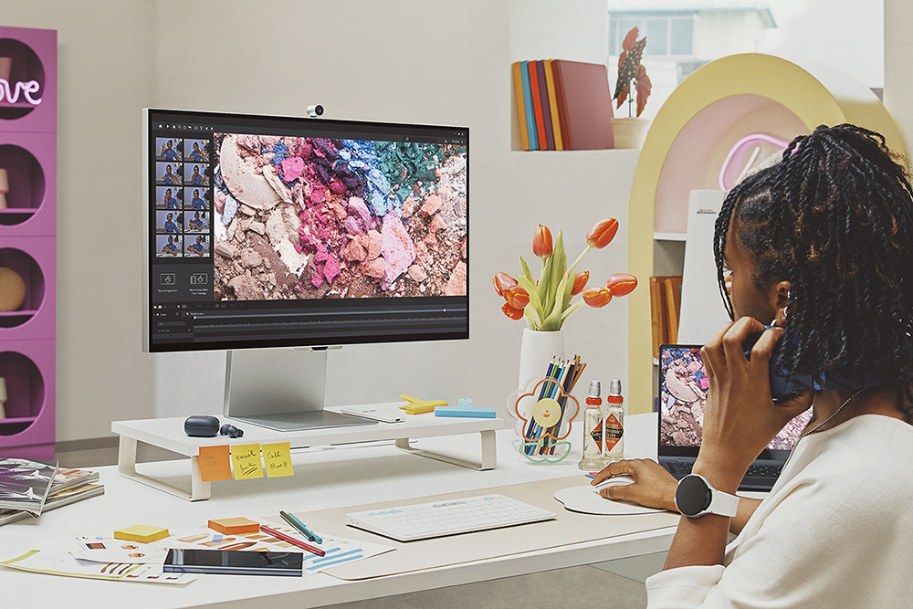
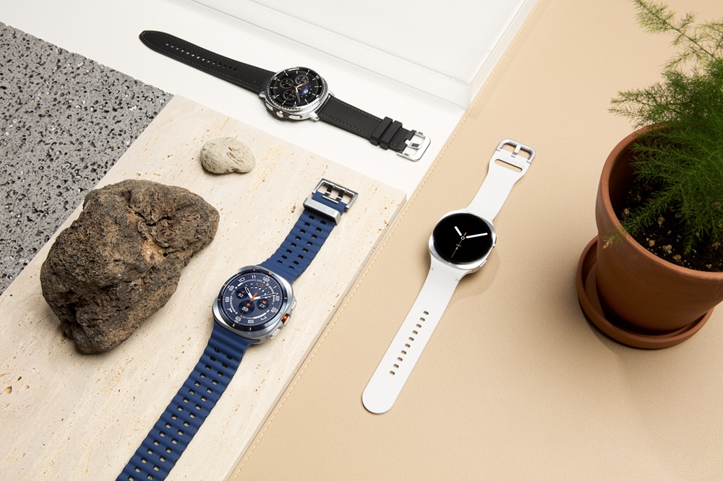
The Electronics Shop: a focused head and a long tail
4 · THE PLAN
HEAD · LAUNCH
TAIL · LAUNCH
LATER
Samsung, sold 1P
Accessories, dropshipped
Apple, TVs and appliances
Galaxy Buds, Watch, Tab and chargers; a few Galaxy Book laptops where the quote works
Cases, cables, chargers, keyboards and mice from distributor feeds. Adds SKUs toward a large catalog with no inventory
Apple through the right reseller channel (slide 18). TVs and appliances once freight and installation are solved
Distributor direct-ship needs a reseller account and resale certificates; terms vary by product. Photos: Samsung Newsroom product images, not Company X stock.
Notes:
Sources:
- Ingram Micro reseller/direct-ship overview (VARStreet blog; verify with Ingram): https://blog.varstreetinc.com/how-to-start-an-online-reselling-business-using-ingram-micro/
- D&H dropship feed integration: https://www.inventorysource.com/dropshippers/dh-distributing/

Slide 14
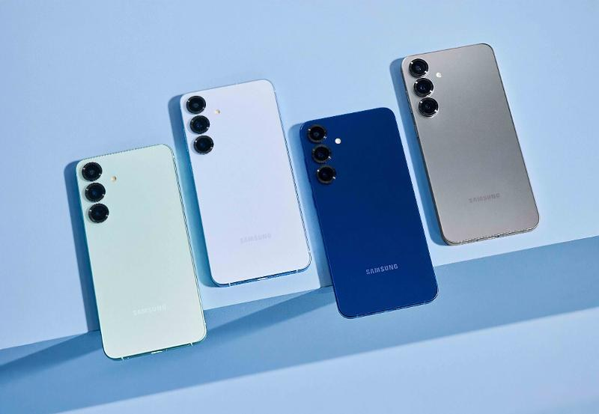
Competitor prices set the most we can pay for stock
4 · THE PLAN
If the rival sells at
After a $20 rival promotion
$149.99
$129.99
we can pay at most
we can pay at most
$116.34
$96.92
Price-check every SKU before buying
Ask Samsung for price protection if rivals cut
Skip SKUs where the quote is above the ceiling
A $20 promotion by Best Buy removes $19.42 of our buying room.
All inputs are planning assumptions. Ceiling = price × 0.971 − $0.30 − $7 shipping − $8 marketing − $4 returns/fraud − $10 profit target.
Notes:
Sources:
- Best Buy price match: https://www.bestbuy.com/site/price-match-guarantee/best-buy-price-match-guarantee/pcmcat297300050000.c?id=pcmcat297300050000
- Stripe US pricing: https://stripe.com/us/pricing

Slide 15
One $90 order: selling it ourselves earns money; a 6% commission does not
4 · THE PLAN
Per $90 order | Company X sells (1P) | Seller pays 6% (3P)
What Company X keeps from the sale | $27.00 margin | $5.40 fee
After refunds on returned orders | $25.57 | $5.11
Card processing (Company X takes payment) | −$2.91 | −$2.91
Shipping to customer | −$6.00 | $0 (seller ships)
Return and dispute losses | −$0.98 | −$0.22
Marketing to win the order | −$8.00 | −$8.00
Profit per order | $7.68 | −$6.02
391
orders a month cover $3,000 of fixed cost ($2,000 role cost + $1,000 other, assumed)
A 3P order needs about 13% commission to break even with $8 marketing. So Company X sells Samsung itself first; third-party electronics come later.
Planning assumptions, not quotes: $63 landed cost, 5% returns, 0.3% lost disputes, 2.9% + $0.30 card fee, $8 marketing. 6% = assumed marketplace fee.

Slide 16
Marketing cost decides whether this works, so start with free traffic
4 · THE PLAN
Where the first customers come from
1
Company X’s own shoppers
Email and on-site banners to existing buyers. Near-zero cost
2
Google free product listings
Merchant Center feed of the Electronics Shop. No cost per click
3
Bundles and compatibility pages
“Which charger fits my Galaxy?” pages that earn search traffic
4
Small paid search, only on SKUs that clear the limit
Most we can spend to win an order: $15.68, before any fixed cost
Stop any campaign above $15.68 per order
Each bar changes one assumption from the $90 base case and holds everything else fixed.
Notes:
Sources:
Source: Google free listings: https://support.google.com/merchants/answer/13889434

Slide 17
Operations: one stock pool, one clear promise, one owner
5 · RUNNING IT
1
Ship
2
Return policy
3
Own
Samsung or distributor ships, or one 3PL; one stock pool at first
Ground parcel, typically 2–5 business days
Quote a Northeast and a central warehouse on real ZIP codes
Lithium-battery and signature rules checked per SKU
Change of mind: the founder’s call, from final sale to sealed-only 7–14 days
Dead, damaged or wrong: replace or refund within 30 days
Policy shown before payment (NY GBL §218-a)
Refund within 5 business days of inspection
I own assortment, pricing, listings and the scorecard
A named person handles orders and refunds every day
A backup when I’m not working
Weekly review of every complaint
A strict policy is legal if shown before payment. Keep a defect remedy: a lost card dispute costs about $87 on a $90 order, a return about $15.
Sources: carrier service pages (USPS, UPS, FedEx); NYC DCWP refund guidance; NY GBL §218-a. Policy is a proposal for your approval.
Notes:
Sources:
- USPS Ground Advantage: https://faq.usps.com/articles/FAQ/Delayed-Mail-and-Packages
- UPS Ground: https://www.ups.com/us/en/support/shipping-support/shipping-services/domestic
- FedEx Ground: https://www.fedex.com/en-us/shipping/ground.html
- NYC refunds guidance: https://www.nyc.gov/assets/dca/downloads/pdf/consumers/ImportantInformationaboutRefunds.pdf
- NY GBL 218-a: https://www.nysenate.gov/legislation/laws/GBS/218-A

Slide 18
Apple: build the route; don’t assume it
5 · RUNNING IT
0–3 months
3–6 months
6–12 months
12–24 months
Ask the right door
Build a record
Apply if invited
Expand
Call Apple’s US reseller referral line (1-800-538-9696) for the consumer online-retail route; ask distributors which program fits
Run Samsung well: sales, on-time delivery, low defects, clean finances
Submit the application the correct channel names; get written rights for the company’s website
Add approved Apple SKUs, or keep compatible accessories and honest refurbished stock
What I checked: TD SYNNEX’s published Apple programs are for business customers and exclude retail and online retail; one also restricts third-party marketplaces. Apple’s MFi program licenses accessories; it is not permission to resell Apple hardware. No public minimums for consumer online resellers were found, so we ask Apple directly.
Sources: apple.com/contact; TD SYNNEX Apple partner and transactional reseller pages; Apple MFi program. Months are a Company X planning window, not an Apple timeline.
Notes:
Sources:
- https://www.apple.com/contact/
- https://www.tdsynnex.com/na/us/apple/distribution-partner-program/
- https://www.tdsynnex.com/na/us/apple/apple-transactional-reseller/
- https://mfi.apple.com/en/home

Slide 19
Operating model: half business, half analytics
5 · RUNNING IT
What the category lead owns
Weekly scorecard | Guardrail | If missed
Profit per order | ≥ $7.68 | Reprice or drop the SKU
Marketing cost per order | ≤ $15.68 | Pause the campaign
Landed cost vs. ceiling | Below ceiling | Don’t reorder
Return rate | ≤ 5% | Fix listing or remove
30-day sell-through | Track by SKU | Cut slow stock
Orders per month | 391 to break even | Review plan at day 90
Business: Samsung terms and quotes, assortment, pricing, listings, bundles, promotions
Analytics: tracking, a weekly scorecard and a one-page decision memo
Suppliers: distributor accounts and dropship feeds for accessories
Customers: policy pages, question answers, complaint review
Tie the category lead’s incentive to profit after marketing, not sales volume.
Guardrails come from the planning model on slides 14–16 and will be reset with real supplier quotes and pilot data.

Slide 20
The first 90 days, with a go/no-go at each step
5 · RUNNING IT
Days 1–30
Days 31–60
Days 61–90
Prepare
Pilot
Decide
Samsung price list and terms in writing
Pick 15–25 SKUs that clear the price ceiling
Shop page, product pages and return policy
Tracking and scorecard live
Open one distributor account
Capped first buy: about $6,300
Launch to Company X shoppers + Google listings
Test a dropship accessory feed
Weekly scorecard to you
Profit by SKU after returns
Reorder winners, cut losers
Decide: scale, adjust or stop
Start the Apple inquiry
Go if: written terms + SKUs clear the ceiling
Go if: profit per order is positive after marketing
Go if: on track to 391 orders a month
Dates depend on signed supplier terms. The opening buy is an assumption: 100 baskets × $63 landed cost.

Slide 21
Competitor return policies at a glance
APPENDIX
Retailer | Returns | Warranty
Best Buy | 15 days on most; 60 for Plus/Total members | Manufacturer + optional protection
P.C. Richard & Son | 30 days, factory-sealed; conditions | Manufacturer + optional service plans
Amazon | Generally 30 days; category and seller exceptions | Depends on brand and seller
Walmart | Own electronics 30 days; marketplace electronics generally 14 | Brand/seller terms; optional protection
Costco | 90 days for listed electronics | Extended coverage on eligible items
B&H | 30 days; opened computers excluded | Manufacturer warranty; check SKU
Micro Center | 15 days for listed tech; 30 for most items | Manufacturer + optional plans
Back Market | 30-day free returns | 1-year seller warranty
Published policies checked Oct 16 2026; each has product and seller exclusions. Sources in notes.
Notes:
Sources:
- Best Buy: https://www.bestbuy.com/site/help-topics/return-exchange-policy/pcmcat260800050014.c?id=pcmcat260800050014
- P.C. Richard: https://www.pcrichard.com/return-policy.html
- Walmart marketplace: https://www.walmart.com/help/article/walmart-marketplace-return-policy/63c3566a9d3546858582acae2fbfdb7e
- Costco: https://techsupport.costco.com/app/answers/detail/a_id/1004434/~/what-is-costcos-return-policy%3F-
- B&H: https://www.bhphotovideo.com/find/cart_returnitem.jsp
- Micro Center: https://www.microcenter.com/site/customer-support/help-center.aspx
- Back Market: https://www.backmarket.com/en-us/legal/warranty

Slide 22
Compliance checklist before launch
APPENDIX
Third-party sellers
Refund disclosure
INFORM Consumers Act: verify identity and bank/tax details for high-volume sellers (200+ sales and $5,000+ in 12 months)
NY GBL §218-a: show the return policy online before payment, including any fees
E-waste
Sales tax
NY: sell only registered brands of covered electronics and share manufacturer take-back information
A NY-based marketplace collects tax on taxable sales it facilitates; other states have their own rules
Honest listings
Reviews
State condition, refurbisher and actual warrantor; no unearned “authorized dealer” badges
FTC rule (Oct 2024) bans fake reviews and buying reviews for a positive rating
Sources: FTC INFORM Consumers Act guidance; NY GBL §218-a; NY DEC electronics retailer requirements; NY Tax marketplace guidance (updated Jan 15 2026).
Notes:
Sources:
- INFORM: https://www.ftc.gov/business-guidance/resources/INFORMAct
- NY GBL 218-a: https://www.nysenate.gov/legislation/laws/GBS/218-A
- NY DEC: https://dec.ny.gov/environmental-protection/recycling-composting/electronic-waste-recycling/requirements-for-retailers
- NY Tax: https://www.tax.ny.gov/pubs_and_bulls/publications/sales/marketplace.htm
- FTC reviews rule: https://www.ftc.gov/business-guidance/resources/consumer-reviews-testimonials-rule-questions-answers

Slide 23
Where every number comes from
APPENDIX
Market
CTA US Consumer Technology Forecast (Jan 2026); Circana releases (Jan 6 and Aug 6 2026)
Best Buy
FY26 10-K and Q4 8-K (Mar 3 2026); Q2 FY27 results and earnings call (Aug 27 2026); bestbuy.com policies
P.C. Richard
pcrichard.com history, memberships, returns, price guarantee and store pages; ECDB online estimate; Wikipedia
Marketplace fees
Amazon, Walmart, Newegg and eBay published seller fee pages; 6% company fee assumed
Company X
The company’s public pages (Oct 2026); details generalized
Model inputs
Planning assumptions (labelled on each slide); Stripe US card pricing; $2,000 role cost (assumption)
All sources accessed Oct 15–17 2026. Full links are in each slide’s speaker notes.

